Slide 1



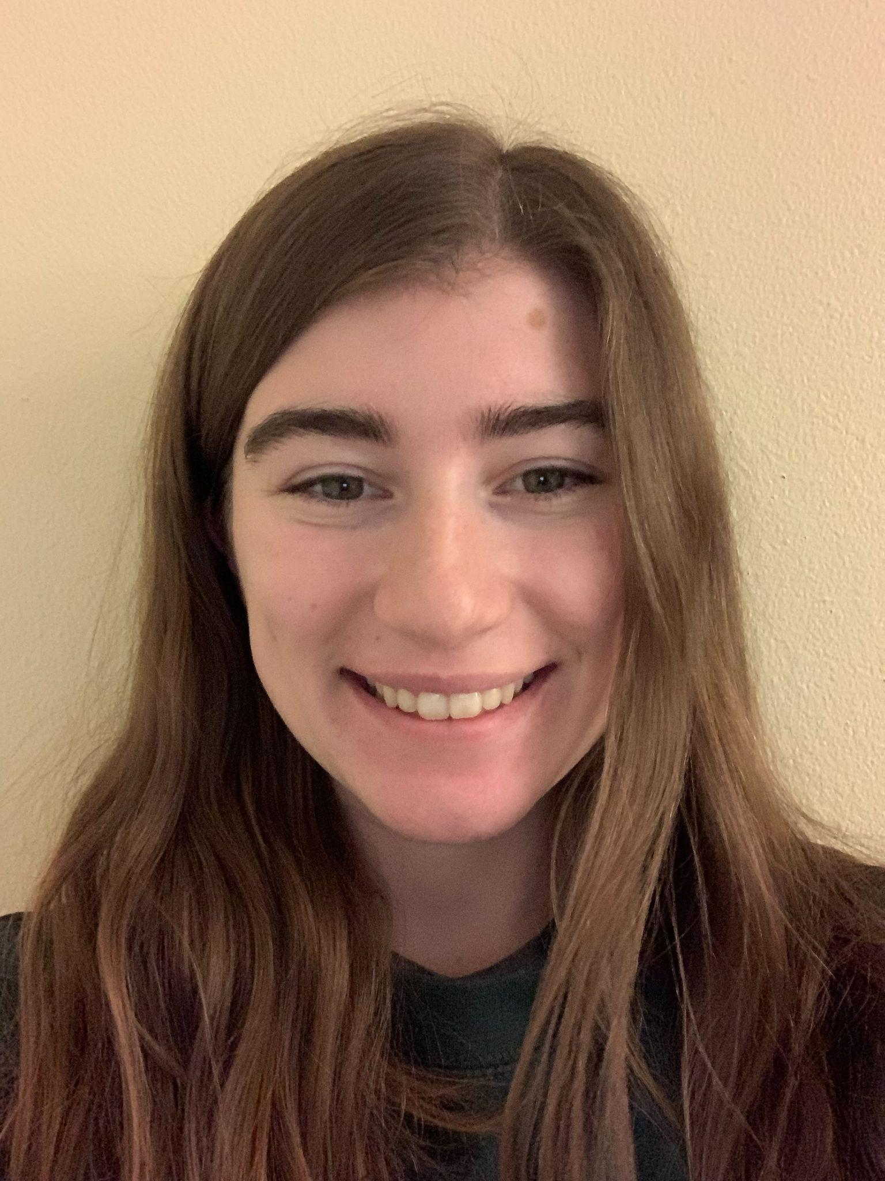

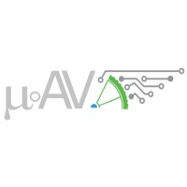

µAV Linked Vehicles
Devin Taing
Project Manager
dpt7@uw.edu
Li-Ling Plume
Outreach
lplume@uw.edu
Fletcher Kurita
Machinist
fletchku@uw.edu
Rebecca Sasten
Mechanical Lead
rsasten@uw.edu
Sponsors/Technical Mentor(s): µAV, Dr. Tyler Folsom
UW Bothell Eng. Advisor(s): Dr. Jong Yoon
2022 — 2023
Notes:
Good morning everyone, my name is Devin. Today I am joined by Li-Ling, Fletcher, and Rebecca to discuss our project for Micro-AV – linked vehicles. Our sponsors are Dr. Tyler Folsom and Micro AV, and received technical advising from Dr. Jong Yoon.

Slide 2
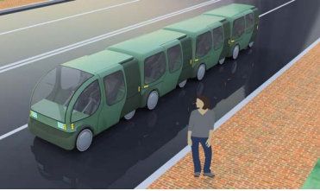
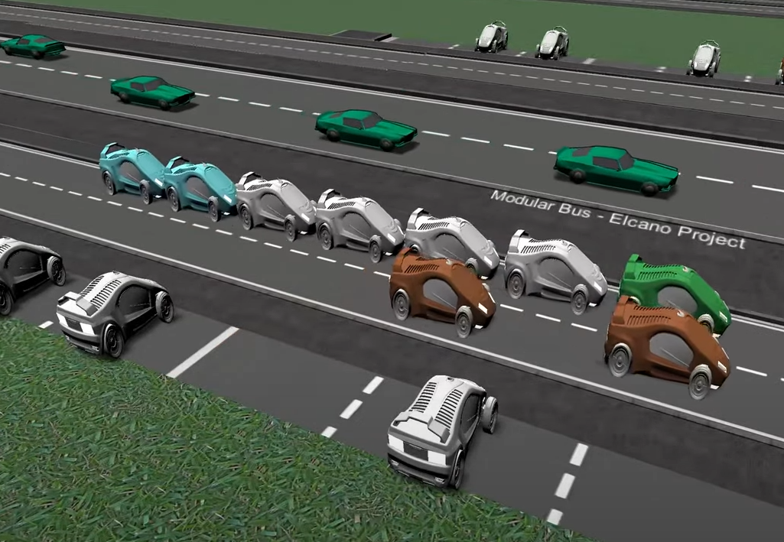
PROBLEM STATEMENT
Background Information: Fuel/cost savings opportunities have been identified in reducing the drag forces experienced by vehicles. Platooning trucks has been found to reduce fuel by 10-17%, with closer following distances resulting in increased fuel savings, up to a maximum amount when coupled.
Current State: Platooning as a fuel saving method exists primarily for long distance vehicles. Physical linking technology is employed for trailers and trains, although usually for pulling carts which do not drive themselves.
Gap Analysis: µAV looks to apply the concept of vehicle-linking to interurban electric micro-vehicles. A proposed modular bus connects independent vehicles which drive themselves to link to one another for as long as their routes align.
Objectives: Design a physically linking system that connects micro-vehicles from bumper to bumper which does not require direct physical interaction for coupling and decoupling.
1
The scope of this project will be to design and construct a prototype coupling device which is compatible with small vehicles following the schedule defined as below.
March
Mechanical system designed and components ordered
Images Courtesy of µAV
SCOPE
November
Needs Statement & Scope Identification
May
Testing methods determined
June
Report out results
WINTER
SPRING
FALL
January
Design Phase Starts
Mid-May
All components ready to test
April
Mech. sys. begins machining
Locking sys. designed
µAV Linked Vehicles 2022 — 2023
Slide 2/6
1 Truck Platooning Evaluations | Transportation and Mobility Research | NREL
Notes:
The need for this project was identified to be a fuel and cost saving opportunity in transportation. Drag forces on vehicles reduce their efficiency, which can counteracted by platooning. Fuel efficiency increases with decreased following distance up to a maximum when vehicles are physically coupled. While platooning and linking solutions exists for larger vehicles like trucks and trains, Micro-AV looks to apply this concept to urban transit for small electric vehicles which are independently driven to form a modular bus. Our project is to design and build the linking system which can couple and decouple as needed. Our scope constrains us to complete it within the capstone period with the allotted budget, and to make it compatible with small vehicles for future capstone work.

Slide 3
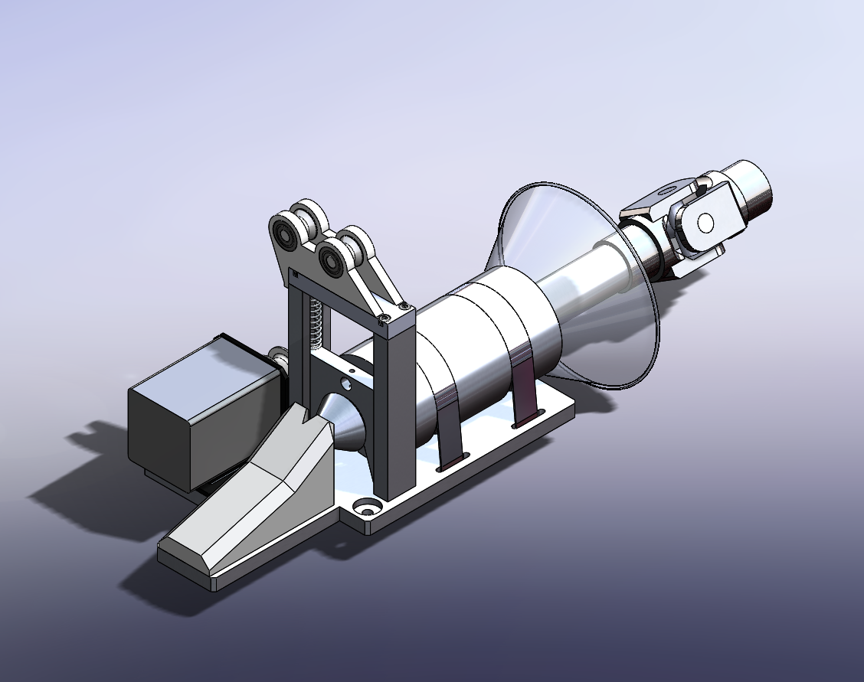
DESIGN METHODOLOGY & SOLUTION DESCRIPTION
Needed to be simple enough to be machined in-house
Withstand 2 x 100 lb masses coupling at 5mph differential
Operate on a dynamically moving platform
Designed from aluminum bar stock
3D print as much as possible
Easily repaired
Pulley System
Male shaft
Lever lock
Female part
Lever lock rails
Motor
Baseplate
Hardstop
µAV Linked Vehicles 2022 — 2023
Slide 3/6
Notes:
Fletcher
The mechanisms components needed to be simple enough to be machined in the universities machine shop. Having the ability to machine parts inhouse brought the overall cost down.
The locking mechanism needed to be able to withstand 2 masses moving at a 5 mph speed differential.
This system needed to be small enough to be mounted on recumbent trikes and withstand dynamic motion and forces
Most parts of this system are designed out of standard easy to find aluminum stock.
The rest are easily replaced except the lever lock which is created with the CNC machine
We 3D printed out ever component that we could
because of this almost every component in the system is easily repaired or replaced

Slide 4
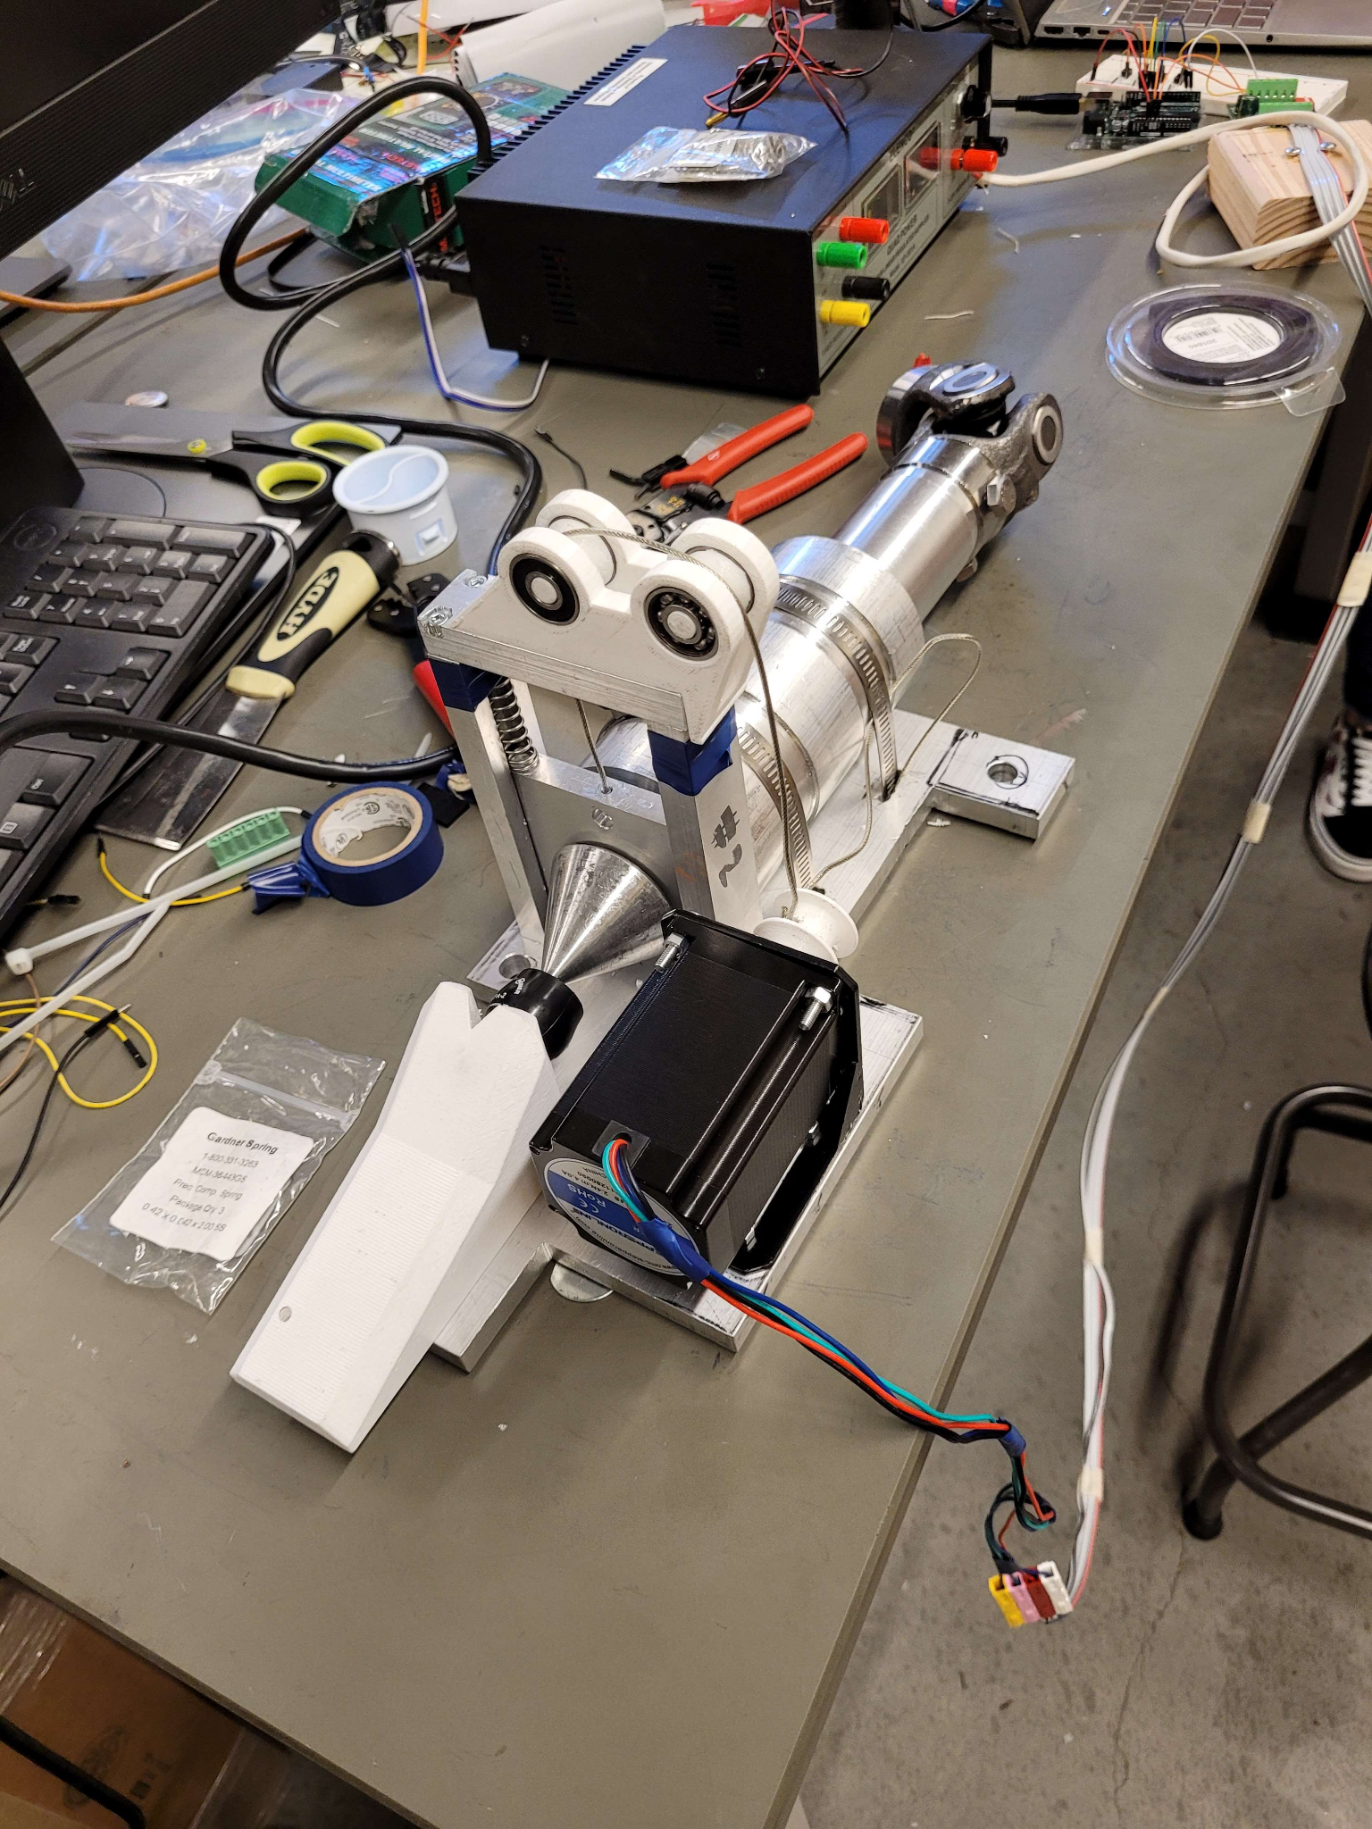
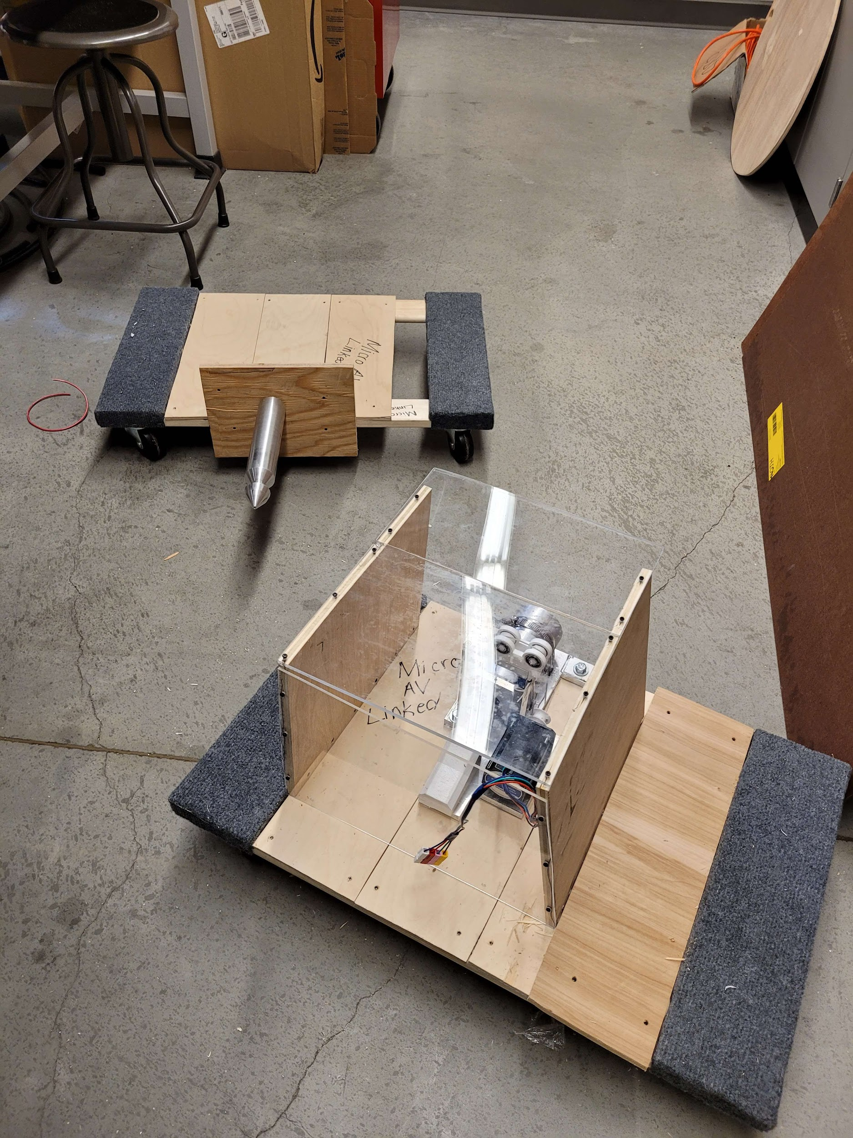
DESIGN METHODOLOGY & SOLUTION DESCRIPTION
µAV Linked Vehicles 2022 — 2023
Slide 3/6
Notes:
Fletcher

Slide 5

DEMONSTRATION, STATUS & RESULTS
Progress:
Complete design and fabrication of coupling/decoupling mechanisms
Test verification of coupling, locking, and decoupling
Evaluation:
Coupling:
Successful coupling and locking
Reasonable force to lift gate and secure shaft
Decoupling:
Motor pulled the gate up high enough to decouple
Jerky motion from motor
Remaining Challenges:
Better position control for motor
Demonstration of coupling/decoupling
µAV Linked Vehicles 2022 — 2023
Slide 4/6
Notes:
Rebecca

Slide 6
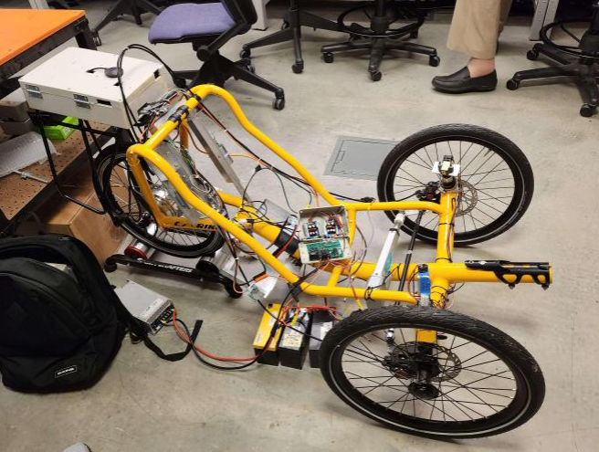
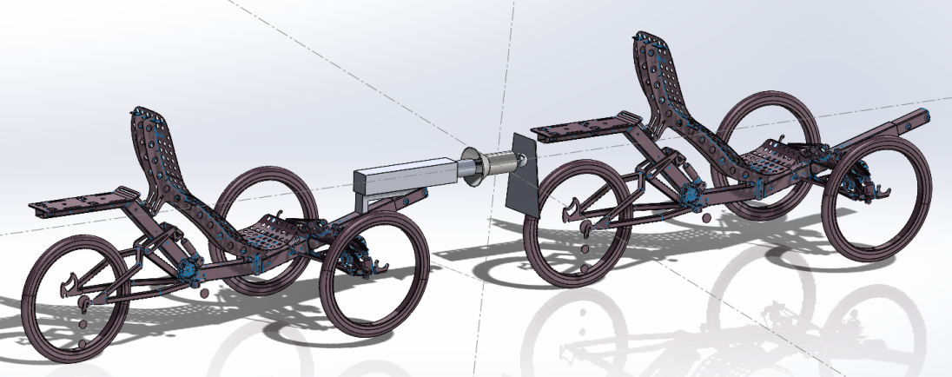
DISCUSSION & CONCLUSION
The system is functional and can couple and decouple two small (mock) vehicles. Progress made to date includes full design from scratch and completed in house machining of the entire assembly
Our team spent too much time in the design and development phase, it would have been beneficial to have more time to fabricate and machine the assembly as nothing in the project was outsourced
In Conclusion the system is operational for a prototype assembly and a beginning proof of concept. Our solution should be expanded on and modified in future (capstone) years.
FUTURE WORK
Future work that will be done to improve the system includes:
Mounting the system to the autonomous trikes (when operational)
Create electrical connection between male and female coupler for data transfer purposes
Improve mechanism to allow for additional degrees of freedom (universal joint)
Integrate additional adjustable shock dampening system for increased user comfort
Machine second set of couplers
Increase weight reductions to the system
µAV Linked Vehicles 2022 — 2023
Slide 5/6
Notes:
Li-Ling

Slide 7

ACKNOWLEDGEMENTS
Team µAV Linked Vehicles wishes to thank:
Faculty mentor: Jong Yoon
Sponsor technical mentor: Tyler Folsom
Sponsor: µAV
Collaboratory: Jacob Roth and Bill Anderson
Without the help of the aforementioned individuals this project would not have been possible.
µAV Linked Vehicles 2022 — 2023
Slide 6/6
Notes:
Li-Ling

